Slide 1



Embeddings-Based Clustering for Target Specific Stances
Ammar Raşid
Prof. Dr. Tanju Erdem
Dr. Reyyan Yeniterzi
github.com/AmmarRashed/UnsupervisedStanceDetection

Slide 2
Outline
Introduction
Related Work
Methodology
Validation
Case study
Conclusion

Slide 3
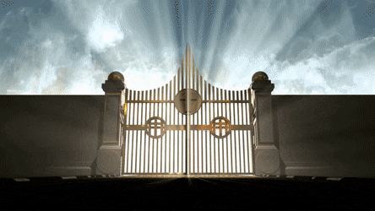
Introduction

Slide 4
What is a stance?
Definition:
The position of a user towards an issue or an entity.
Single:
PRO:
Take the Red Pill, sleep well, WE WILL MAKE AMERICA GREAT AGAIN!
ANTI:
"Make America Great Again" is actually a dog whistle to fascism and white supremacy.
Multiple Targets:
I am a Liverpool fan but today my heart goes out to Newcastle fans
Stance is not sentiment + stance - sentiment: I feel bad that he lost - stance + sentiment: I am so glad he died
Notes:
Add easy stance example sentences

Slide 5
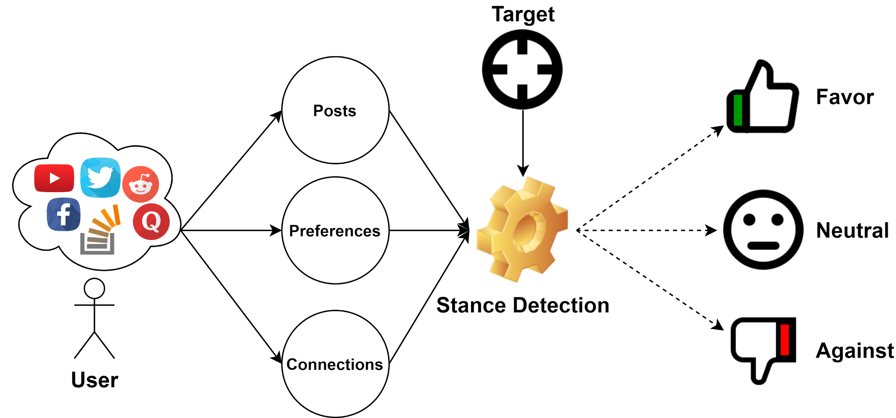
Why stance detection?
Views collection:
Useful for marketing and polling.
Recommendation:
Similar stances could imply similar preferences.
Population Analysis:
Dissecting polarization targets.

Slide 6
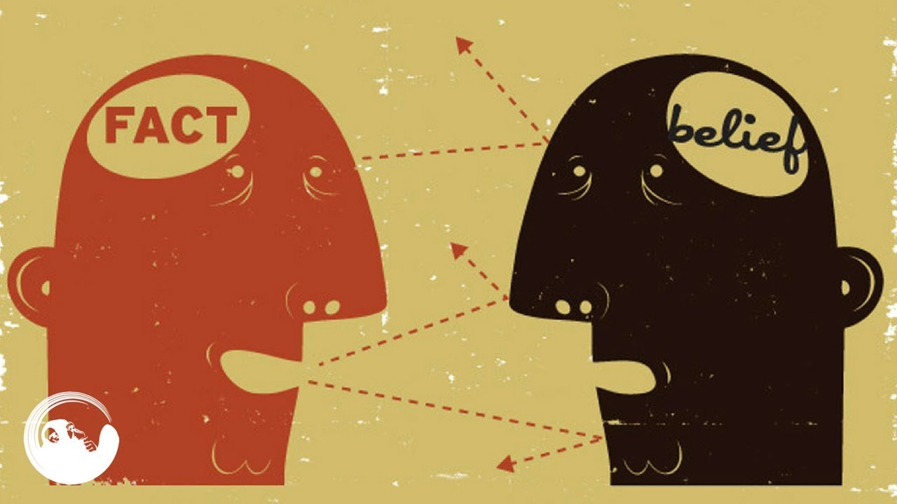


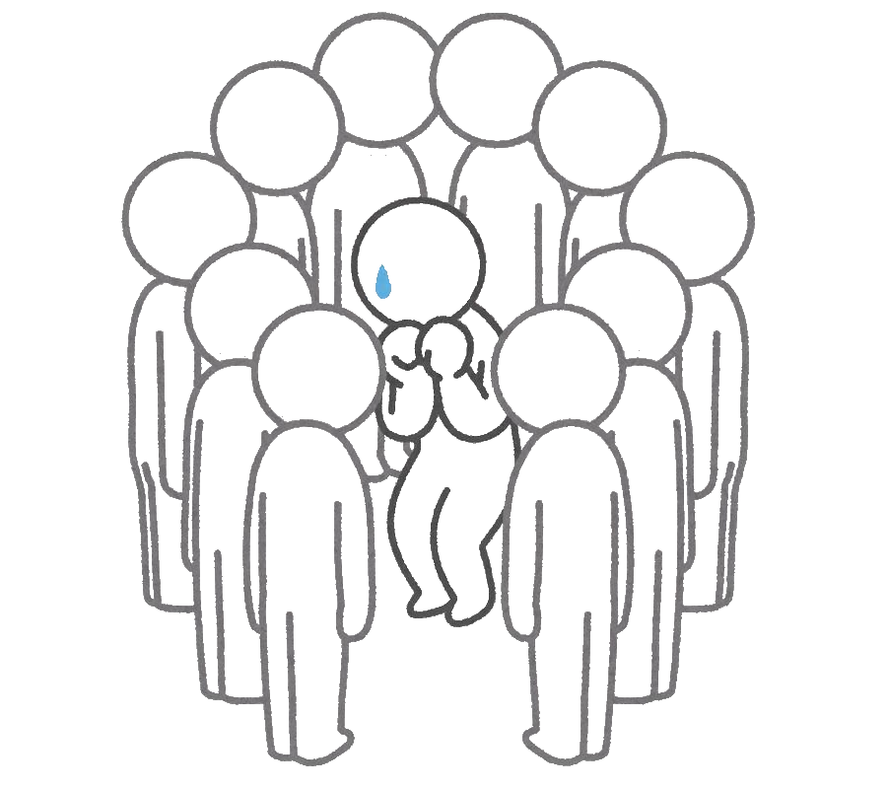
Biased Assimilation
welcome confirming evidence less critically than disconfirming ones.
Echo chambers
closed communities share the same information sources.
4
3
Social Influence
once people are in groups, they influence each other.
2
Homophily
Birds of a feather, flock together
1

Slide 7
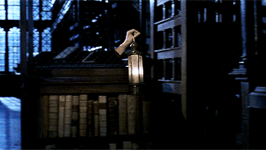
Related Work

Slide 8
Supervised Stance Classification
Pre-trained word embeddings:
MITRE (Zarrella & Marsh 2016): 256-dimensional SkipGram -> LSTM -> RLU
Bidirectional Conditional Encoders (BCE): Augenstein et. al 2016
Cross-Target (Xu et. al 2018): CrossNet: BCE + self-attention mechanism.
DMAN (Wei et. al 2018): dynamic memory augmented network, BCE + attention + memory modules.
Memory networks can provide snippets of the stance evidence in documents
Sentiment Information: “Stance detection via sentiment information and neural network model, Sun et. al (2018)”
jointly learn sentiment and stance information.
Sentiment information is fed to an auxiliary shared LSTM between stance and sentiment data.
Notes:
Add citations, years …
How well did they work

Slide 9
Stance Detection in Twitter
Feature stratification on Twitter:
Text: e.g. n-grams.
Interaction: e.g. retweets, replies, mentions ...etc
Preference: e.g. likes
Connections: e.g. followers, friends ...etc
Model:
Most competitive models used SVM with retweeted accounts as features.
Your stance is exposed!: Aldayel & Magdy 2019
Silent users can still have their stance detected using only their connections (i.e. F1 = 71.39)

Slide 10
Unsupervised Stance Detection
Text-based: “Detection of Stance-Related Characteristics in Social Media Text, Simaki et. al 2018”
21 stance-related text characteristics, e.g. contrariety, hypotheticality, and necessity constructions.
Project using PCA.
Organize projected vectors into 6 clusters of different writing styles.
Interaction-based: “Unsupervised User Stance Detection on Twitter, Darwish et. al 2019”
Hashtags, and retweeted accounts as features.
Project using UMAP.
Cluster with Mean-shift.
Notes:
Provide results
What is missing in these approaches?

Slide 11
Limitations of previous best Unsupervised Stance Detection
Requires platform-specific features.
Requires large amount of data for training.
Does not consider the hierarchy of stances.
Requires specification of the number of clusters.

Slide 12

Methodology

Slide 13
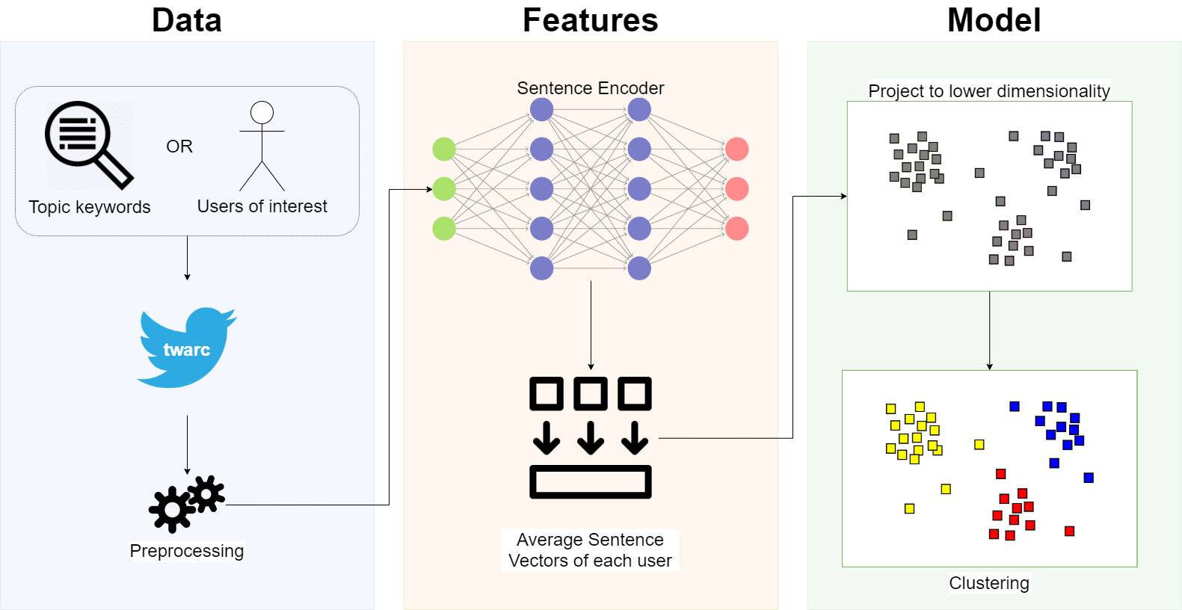
Framework

Slide 14
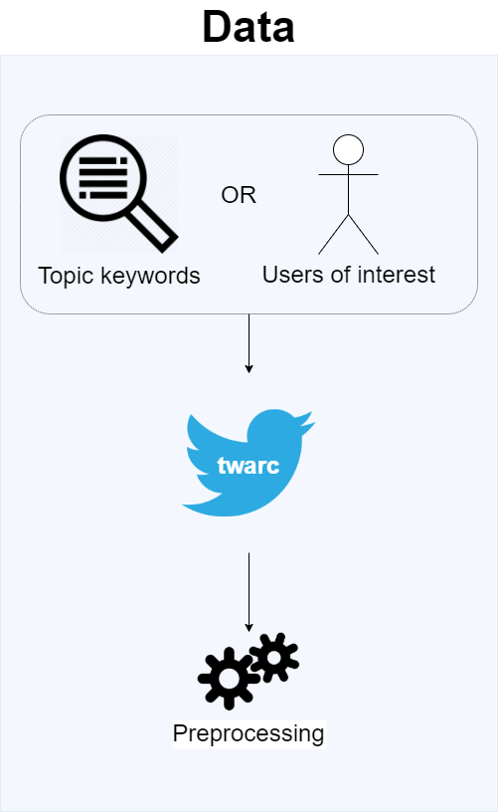
Data
Data Collection
Keywords
Usernames
Cleaning
Converting camel-cased hashtags to space-separated phrase.
Removal of all links, and user mentions.
Removal of all non-letter characters and punctuation.
Replacement of all numbers to the word “number”.
Case folding, where we lowercase all letters.
Filtering
Min 3 tokens per tweet
Min 3 unique tweets per user
Accounts suspended within 8 months are assumed Bots

Slide 15
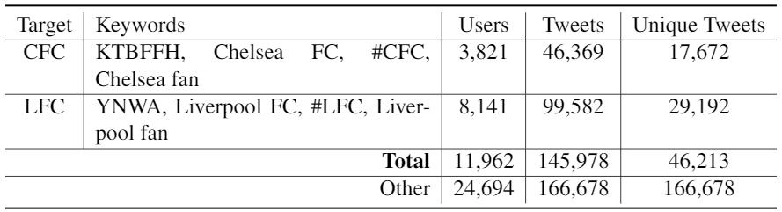
Datasets: UEFA
Topic: UEFA Super Cup, Istanbul 14th of August 2019
Date span: Aug. 8-17, 2019
Language: English
Labels: Liverpool fan (LFC) vs Chelsea fan (CFC)
Nature: More text, less #Hashtags and Retweets
Annotations: match keywords in user bios
Notes:
Mention the difference in nature between the datasets and the reason for that (different behaviour, how?)

Slide 16
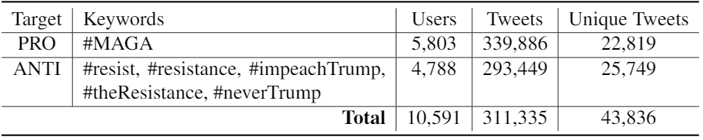
Datasets: Trump
Unsupervised User Stance Detection on Twitter, Darwish et. al 2019
Topic: USA midterm presidential elections
Date span: Oct. 25-27, 2018
Language: English
Labels: Pro Trump (PRO) vs Anti Trump (ANTI)
Nature: Too much #Hashtags & Retweets!
Notes:
Give the citation here

Slide 17
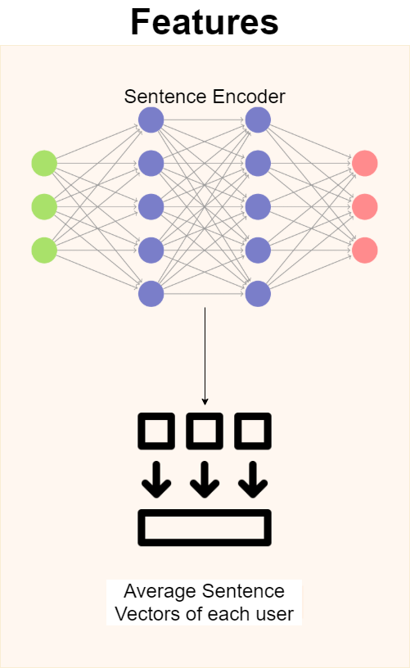
Features
Select:
tweets containing stance targets.
Encode:
tweets using a pre-trained sentence encoder.
Average:
tweet vectors per user to obtain a single vector per user.

Slide 18
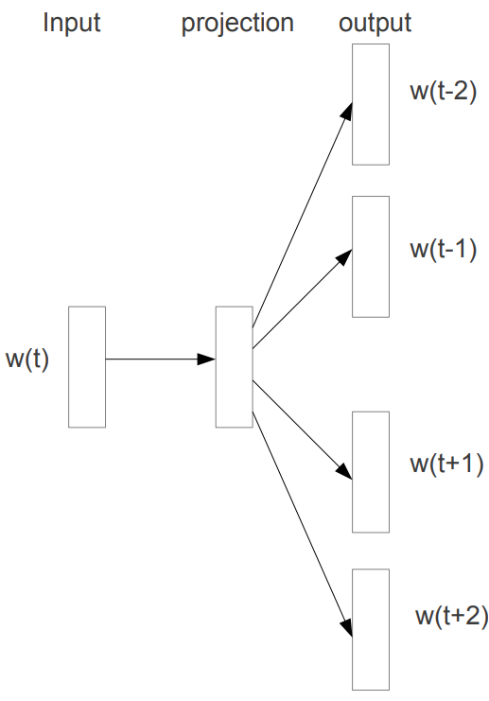
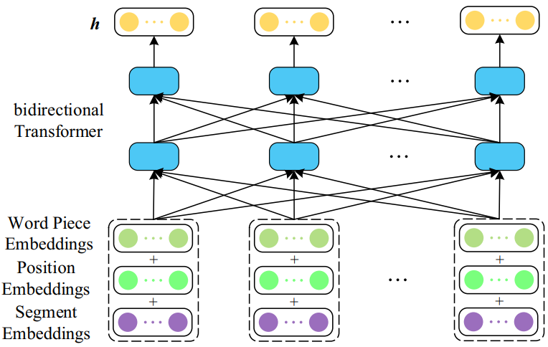
Word Embeddings
Vector representation of words
Similar words have similar contexts.
Vectors of similar words are closer to each other.
Word2Vec: e.g. CBOW, Skip-gram
Transformer Models: e.g. BERT
Skip-gram
BERT
Distributed Representations of Words and Phrases and their Compositionality (Mikolov et.al. 2013)
From static to dynamic word representations: a survey (Wang et.al. 2020)

Slide 19
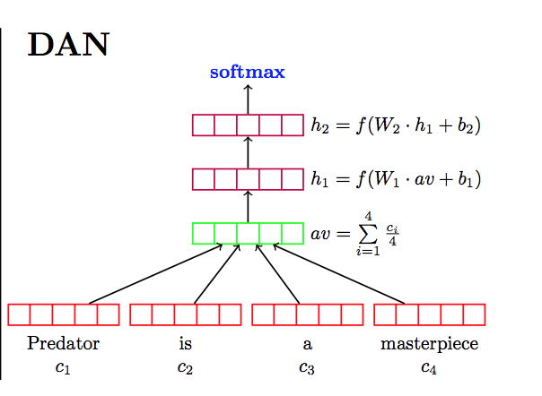
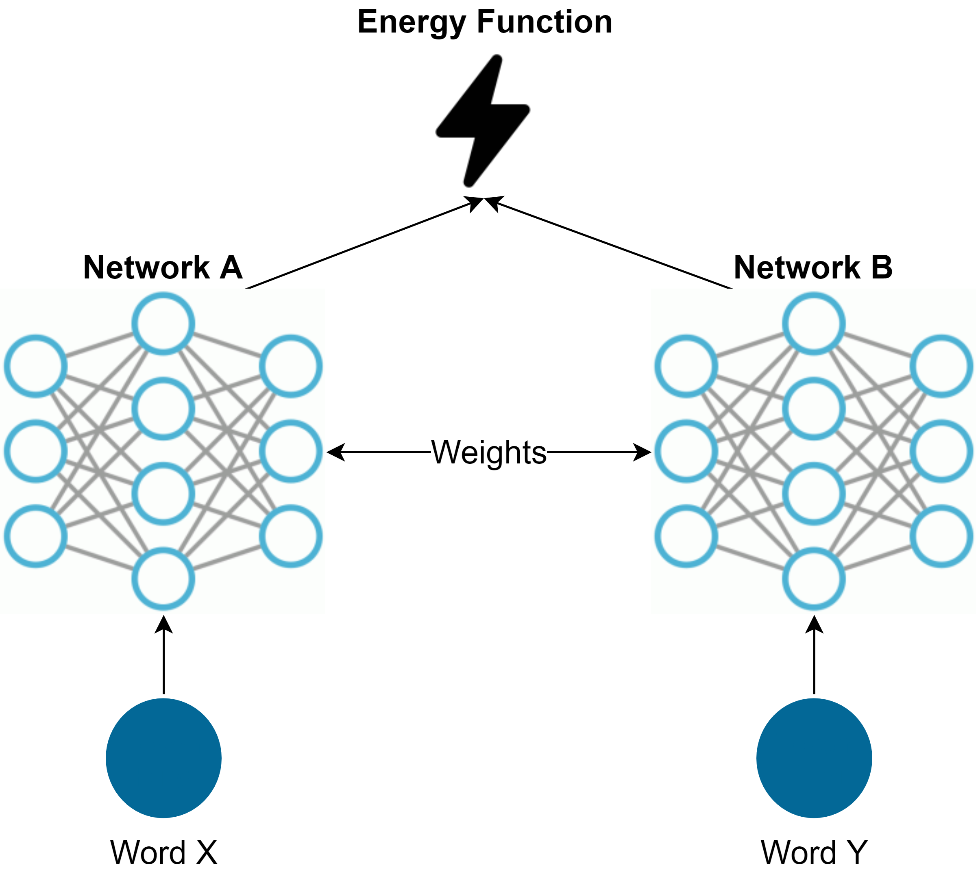
Sentence Encoders
Universal Sentence Encoder (USE):
Average input embeddings.
Pass through feed-forward DNN.
Sentence-BERT:
Modify BERT to use Siamese Networks.
Siamese networks can be twins and triplets.
DAN: Deep Unordered Composition Rivals Syntactic Methods for Text Classification (Iyyer et.al. 2015)
USE: Cer et.al. 2018: https://tfhub.dev/google/universal-sentence-encoder/4
SBERT: Reimers & Gurevych https://github.com/UKPLab/sentence-transformers
Notes:
Separate approaches in different slides (better reorganized)
Add some references
Reproduce the siamese network figure

Slide 20
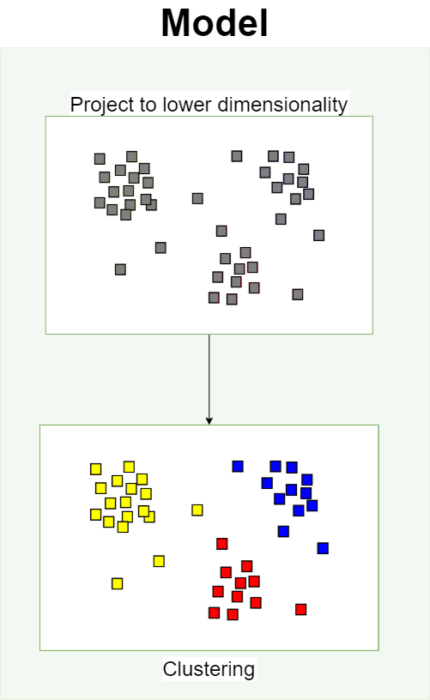
Model
Project:
user vectors onto a lower dimensional space.
Cluster:
projected vectors into clusters of stances.

Slide 21
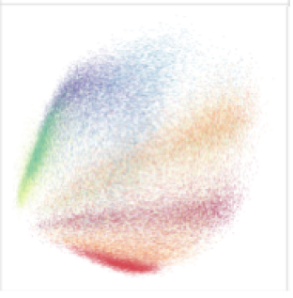
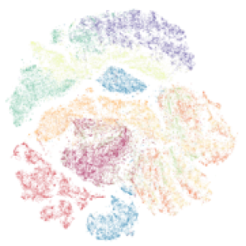
Vector Projection
Taxonomy:
Matrix Factorization: e.g. PCA, LDA
Neighbor Graphs: e.g. t-SNE, UMAP
Principal Component Analysis (PCA):
Assumes latent correlation between variables.
Projects onto a space of an uncorrelated variables.
Maximize variance while preserving long pairwise distances.
Poor with non-linear manifold structures.
t-distributed stochastic neighbor embedding (t-SNE)
Centers a gaussian distribution P about a data point X.
Measures the density of all other data points under that distribution.
Focuses on preserving short pairwise distances.
Source: “UMAP: Uniform Manifold Approximation and Projection for Dimension Reduction” McInnes et. al. 2018

Slide 22
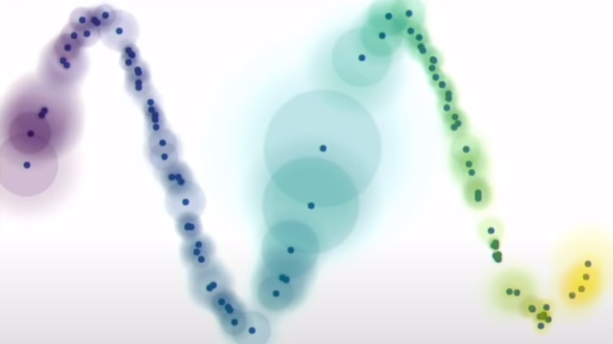
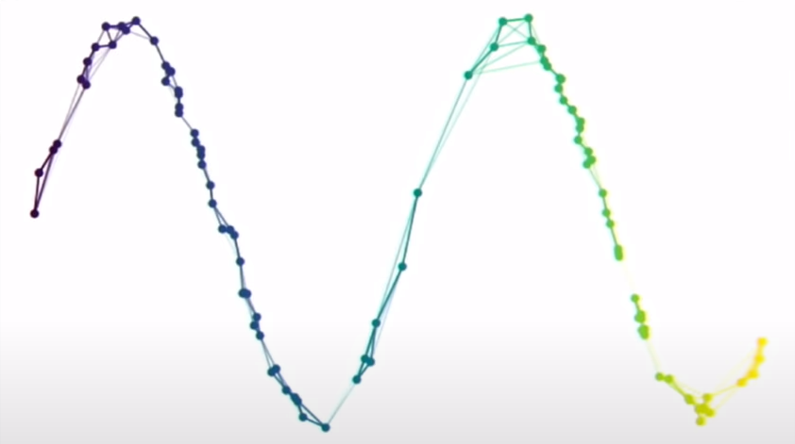
Uniform Manifold Approximation and Projection
Source: https://umap-learn.readthedocs.io/en/latest/how_umap_works.html

Slide 23
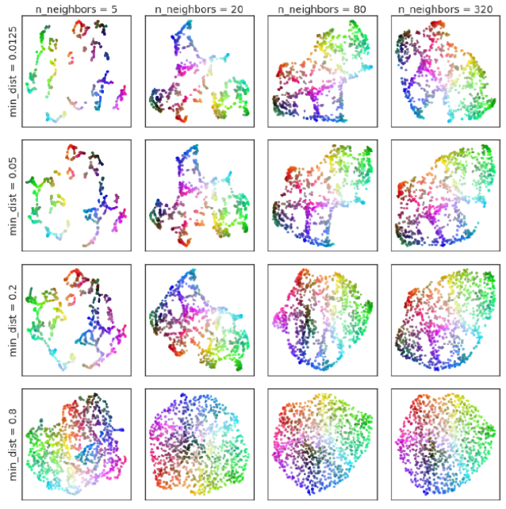
UMAP parameters
min_dist: btw neighbors.
How tightly can UMAP pack elements together.
n_neighbors: in a local structure.
Balance between local and global structures.
Source: “UMAP: Uniform Manifold Approximation and Projection for Dimension Reduction” McInnes et. al. 2018

Slide 24
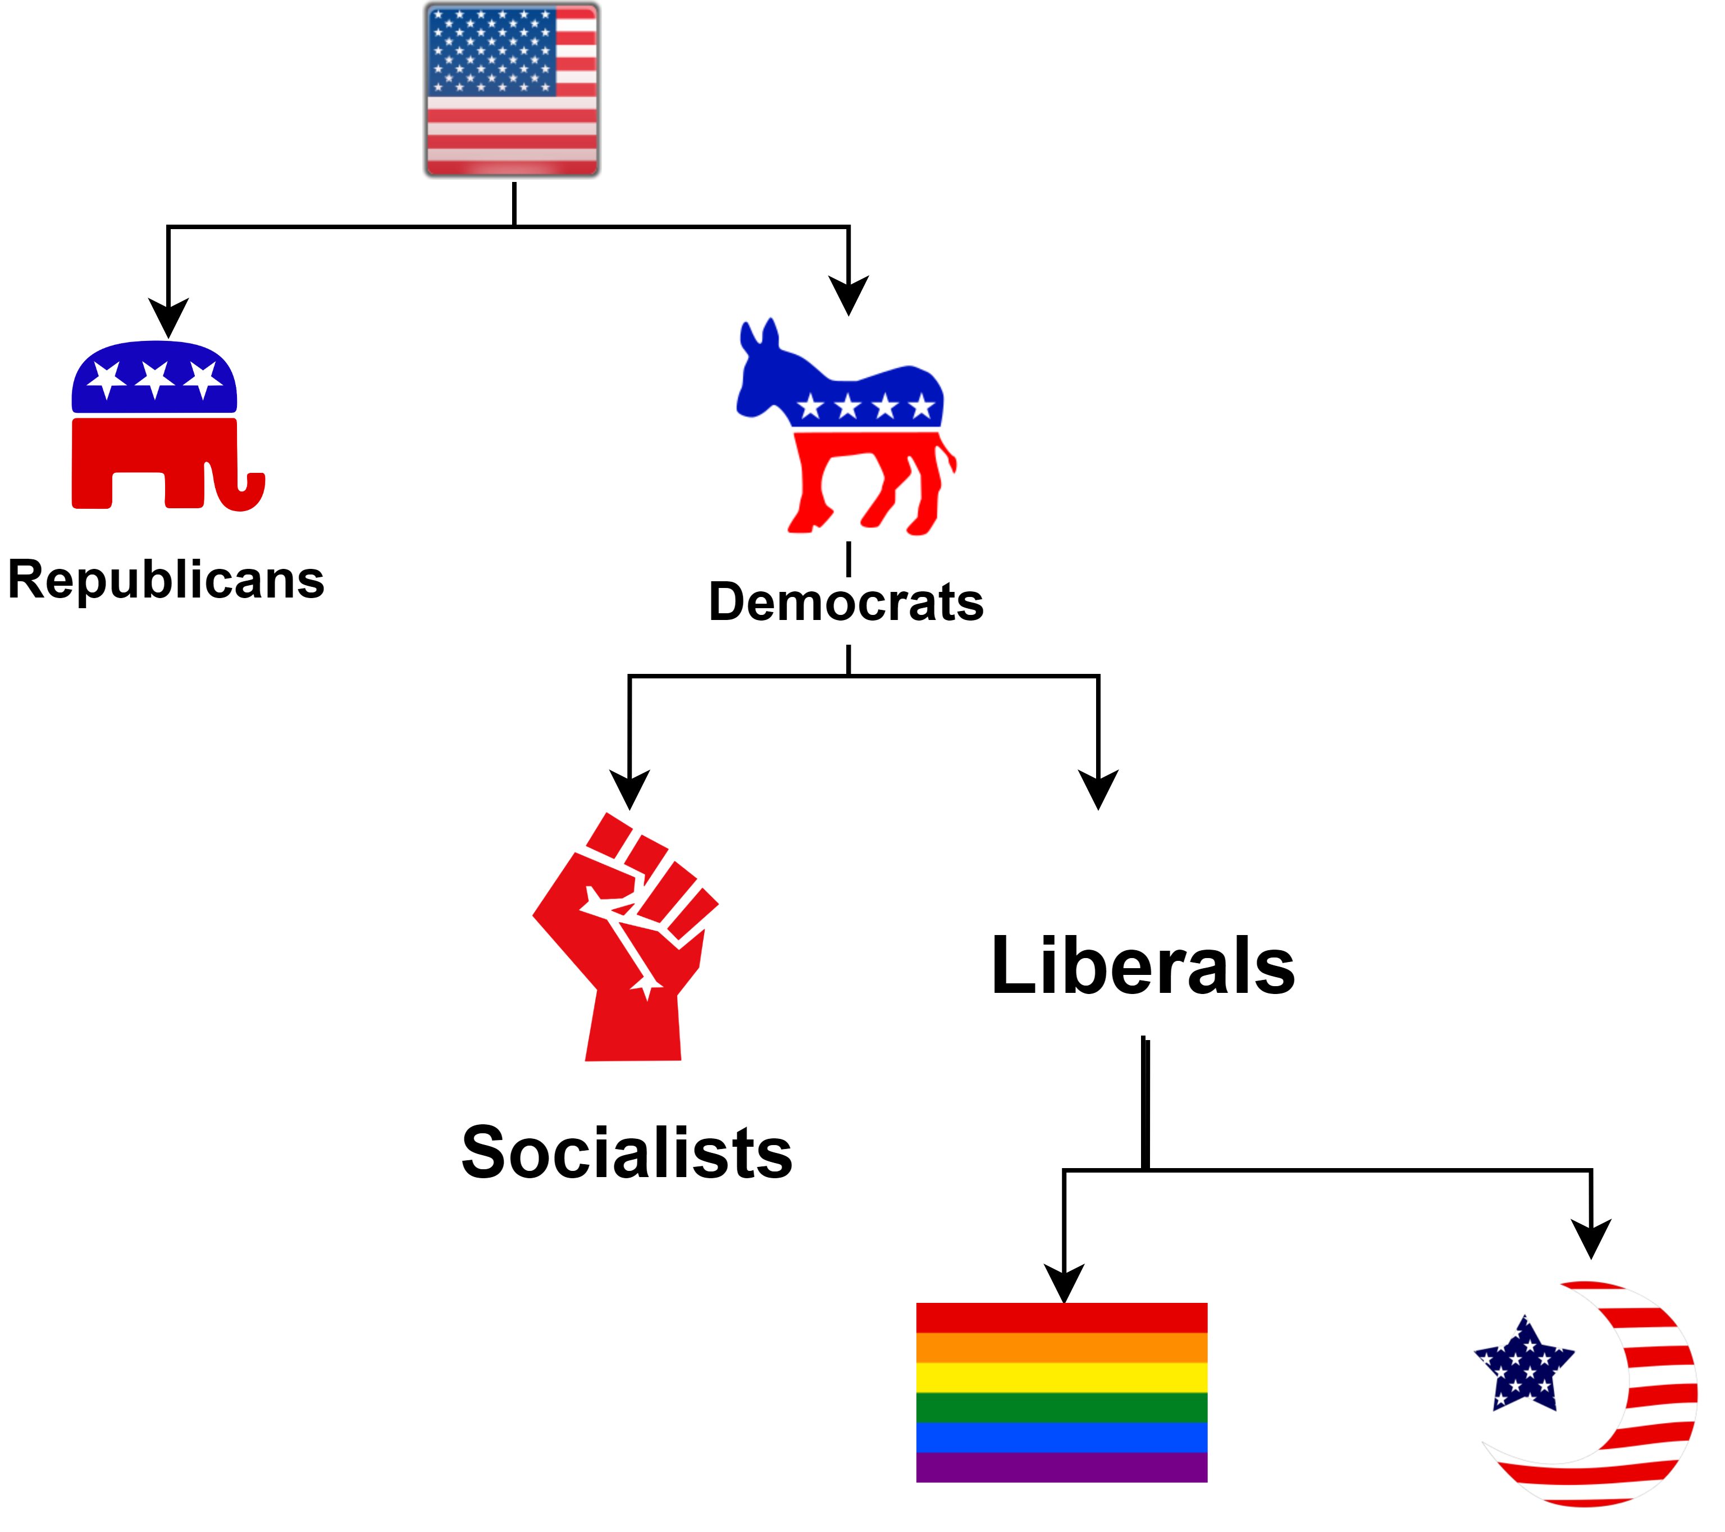
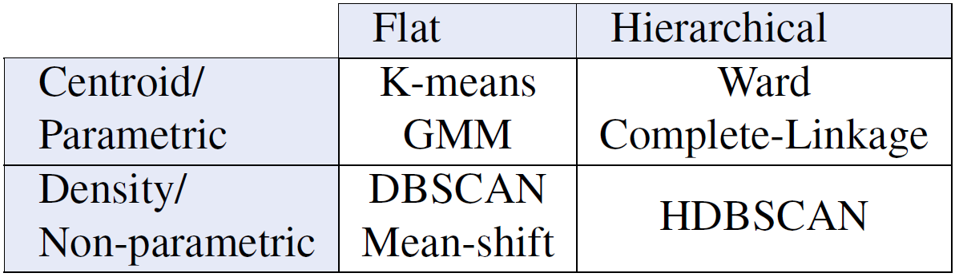
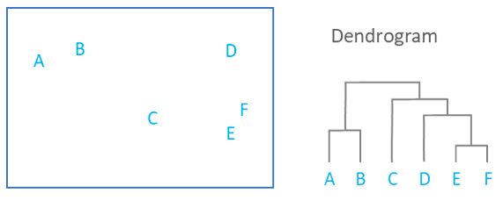
Clustering

Slide 25
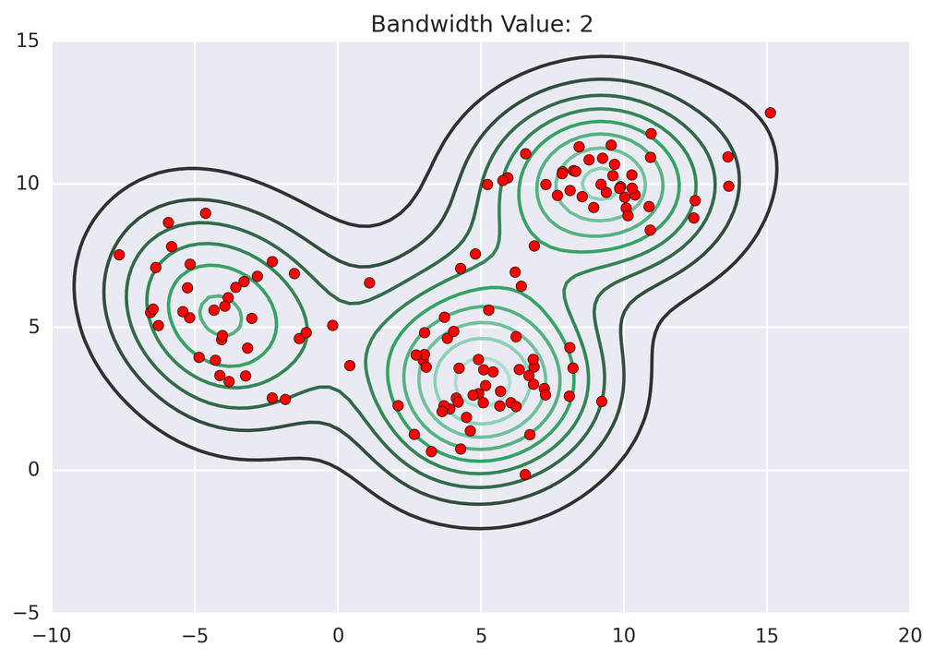
Meanshift
Source: https://informatics.sydney.edu.au/news/msg/

Slide 26
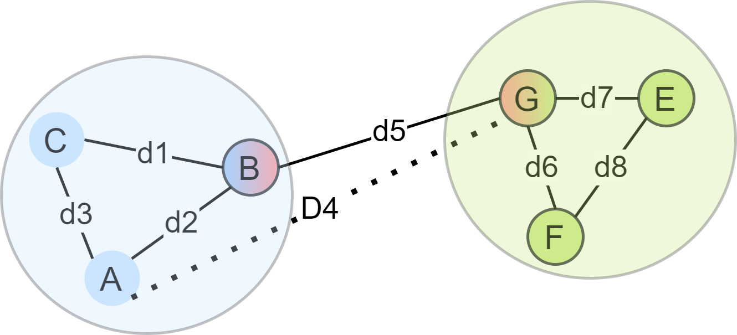
Graph-based modelling
Density-based spatial clustering of applications with noise (DBSCAN):
Edges: if distance is at most 𝝐.
Core Object (CO): a vertex connected to min_{pts} vertices.
Density-connected:
COs directly and transitively 𝝐-reachable.
Weak in clustering data of varying densities.
It is hard to determine 𝝐.
Ordering Points To Identify the Clustering Structure (OPTICS):
Core distance: the distance to the nearest min_{pts} neighbors.
Reachability distance: x → y = max( dist (x, y), core distance of y)
Use priority-queues to represent density-based clustering structure
Notes:
Try to be brief in talking about it. (CUT IT SHORT ya Ammar)

Slide 27
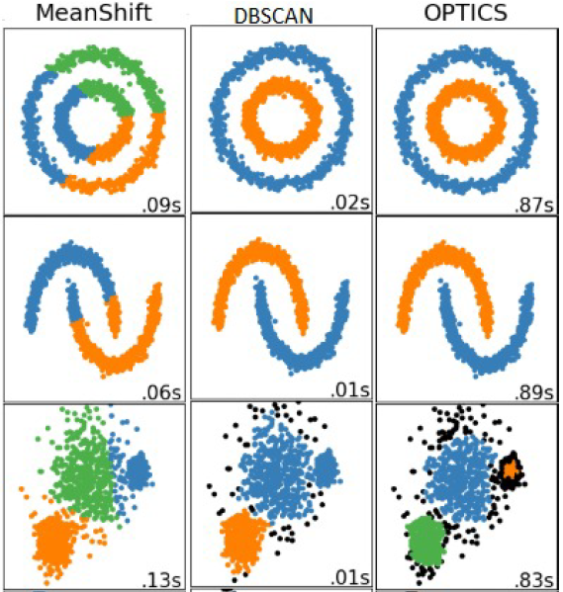
Source: https://scikit-learn.org/stable/auto_examples/cluster/plot_cluster_comparison.html

Slide 28
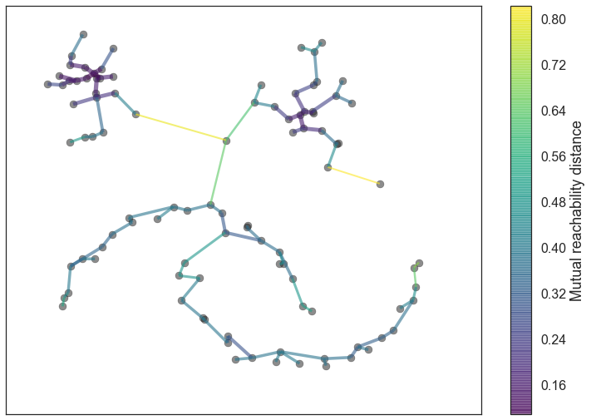
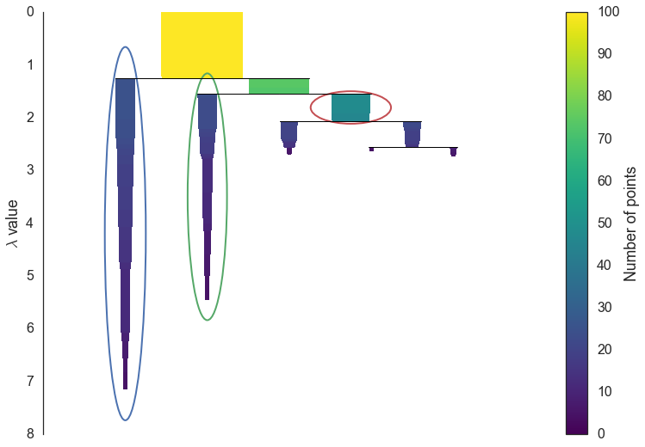
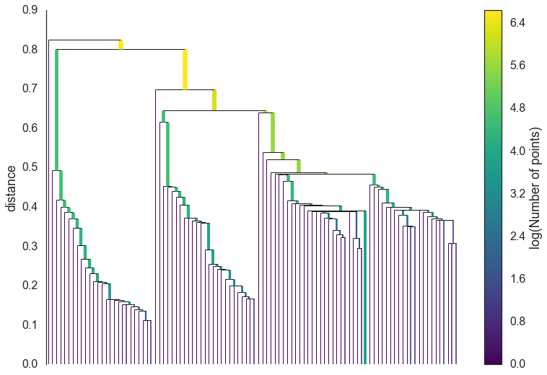
Hierarchical DBSCAN (HDBSCAN)
Generates DBSCAN solutions for varying 𝝐.
Selects clusters with the best stability over 𝝐.
Simplify the tree using a minimum cluster size parameter.
λ = 1 / distance
Source: https://hdbscan.readthedocs.io/en/latest/how_hdbscan_works.html

Slide 29
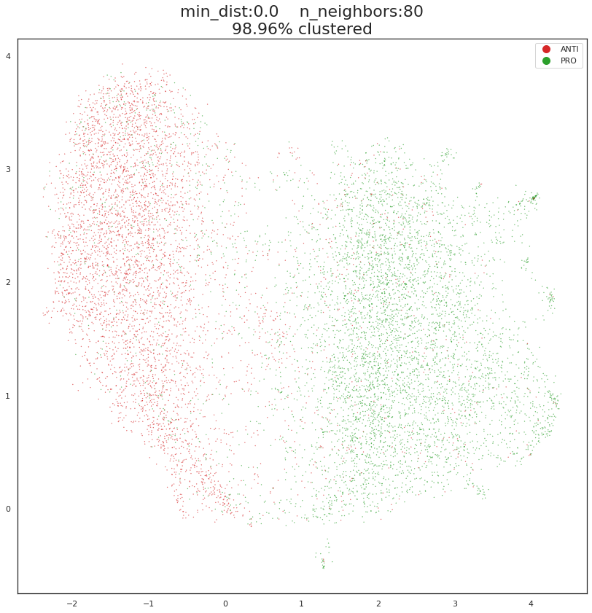
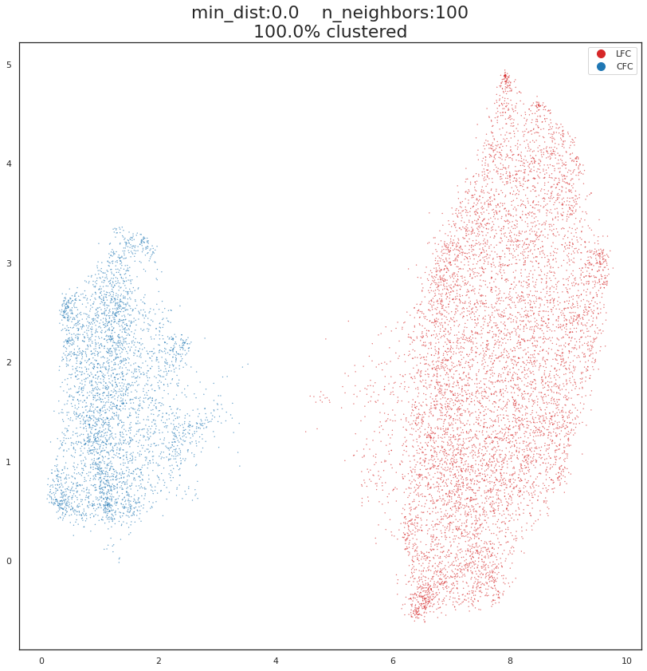
Model
TRUMP
UEFA
PRO
LFC
CFC
ANTI

Slide 30

Experiments
Model Analysis

Slide 31
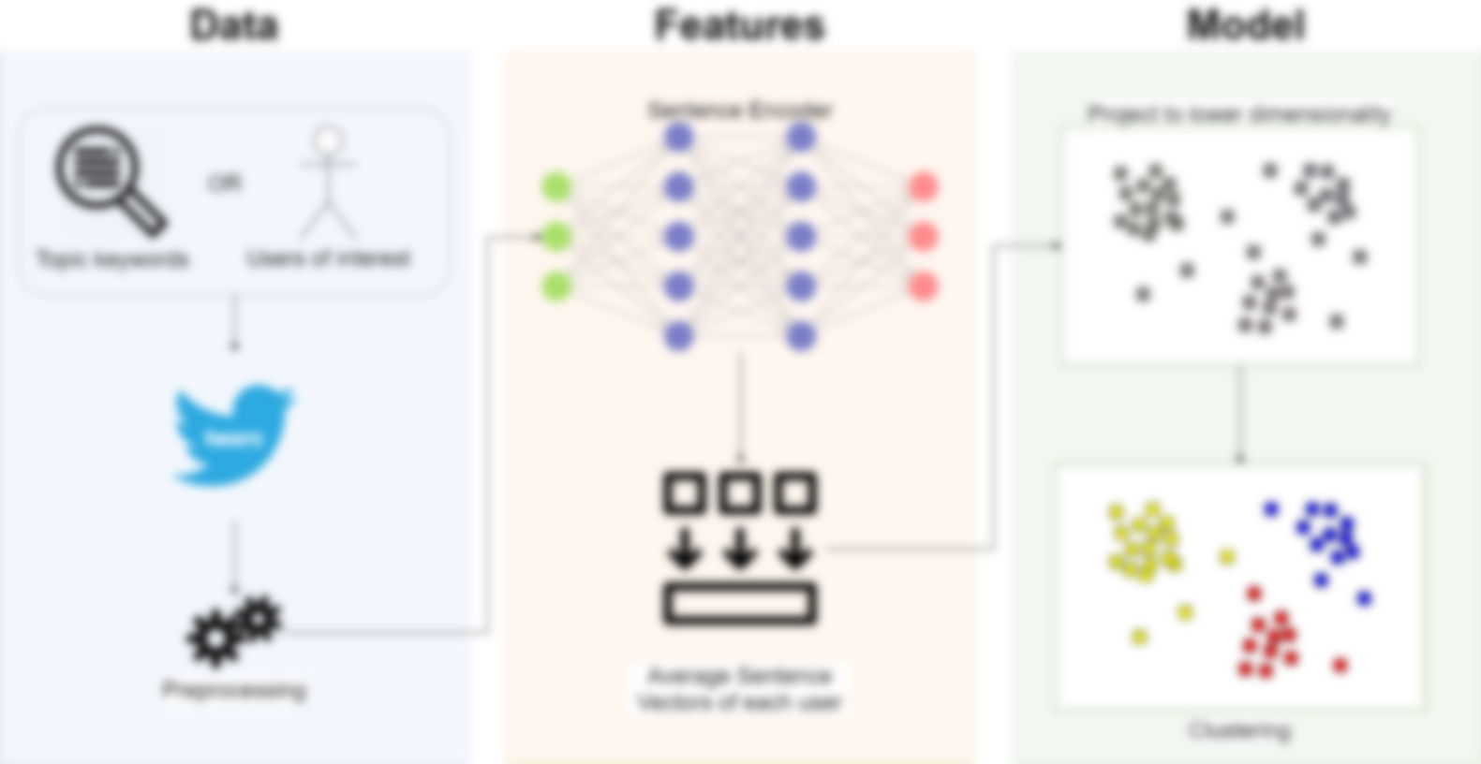

Slide 32
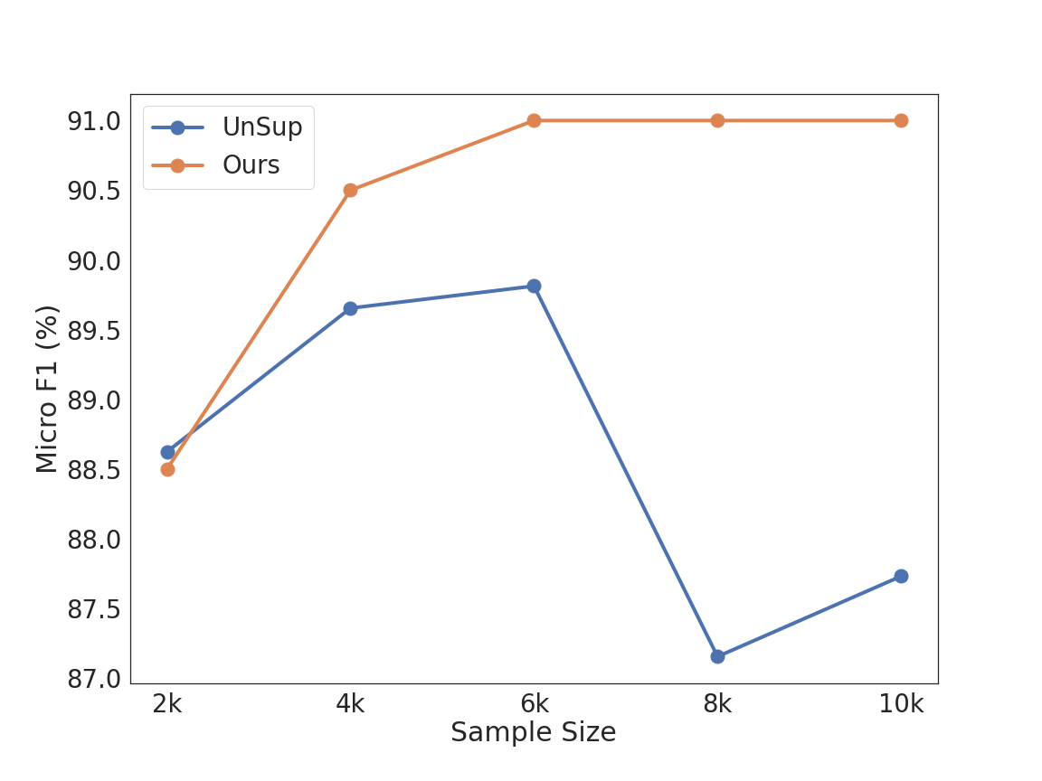
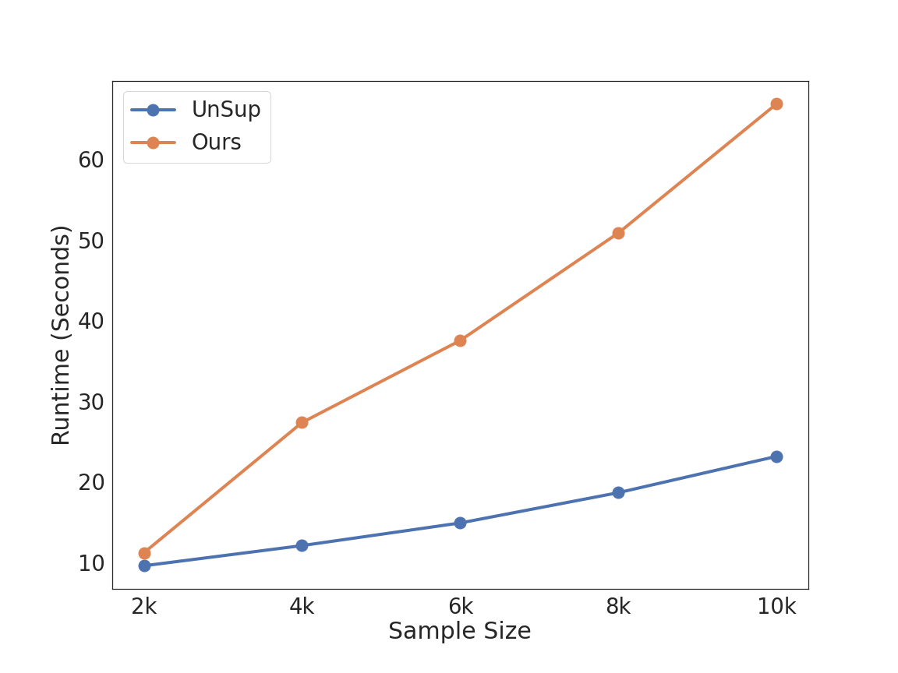
Data: Sample Size

Slide 33
Data: Variance (min unique tweets per user)

Slide 35
Features: Sentence Embeddings

Slide 37
Model: Vector Projection

Slide 38
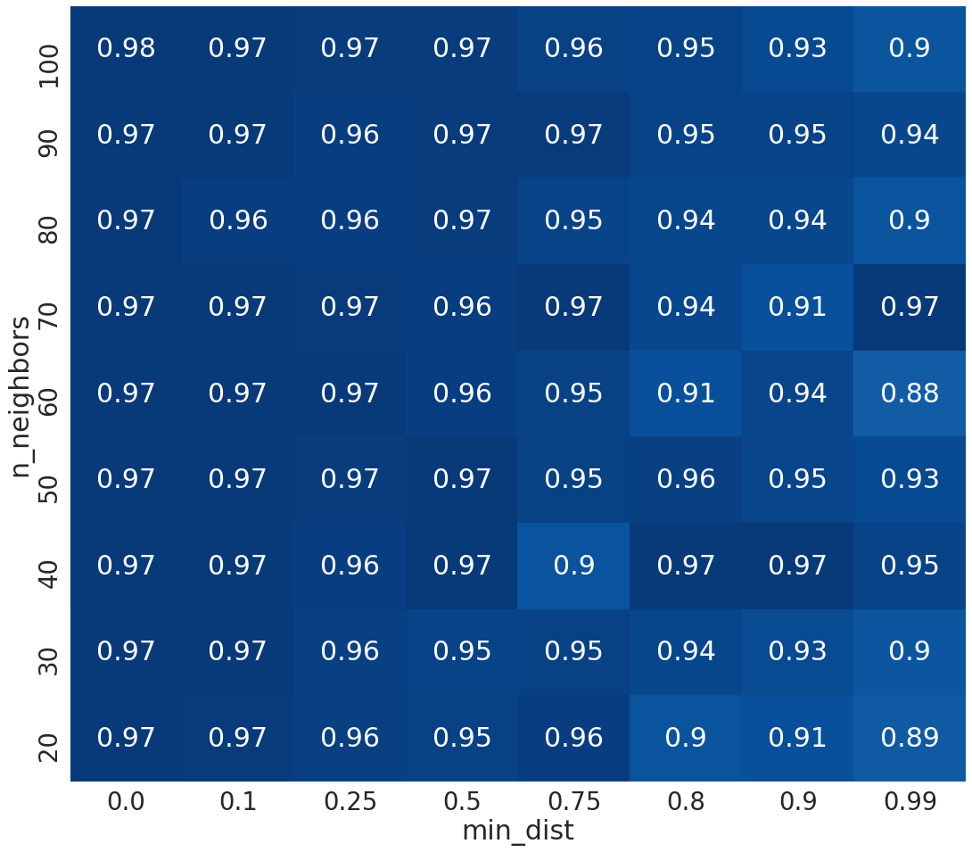
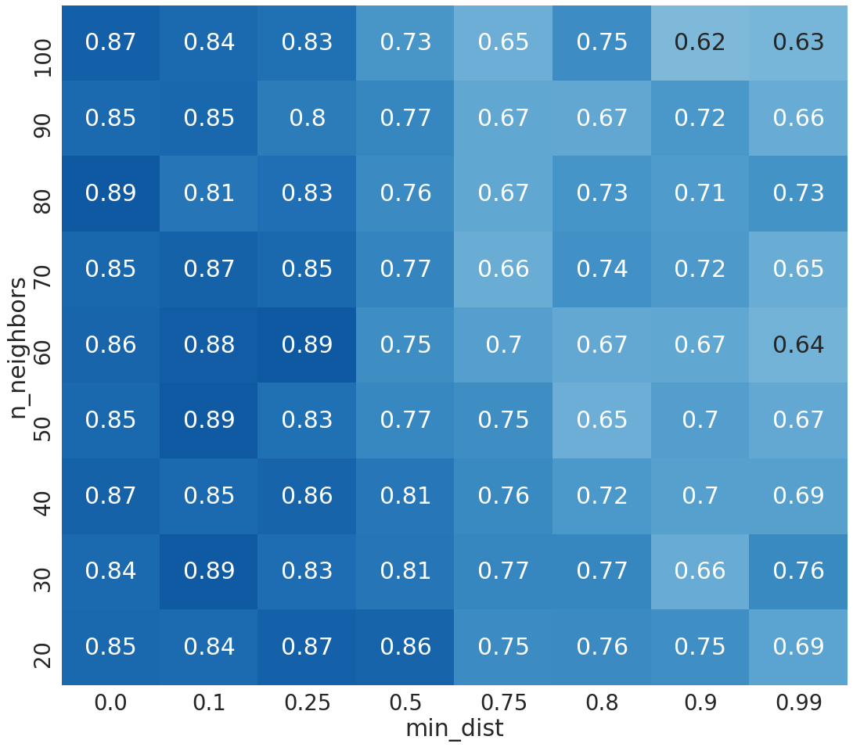
Model: Hyperparameters
UEFA
Trump

Slide 39
How much information is lost with UMAP?

Slide 41
Model: Clustering

Slide 42

Limitations of previous best Unsupervised Stance Detection
Requires platform-specific features.
Requires large amount of data for training.
Does not consider the hierarchy of stances.
Requires specification of the number of clusters.

Slide 43
Experiments
Validation

Slide 44
Baselines
Supervised:
Features: retweeted accounts
Models:
SVM₂₀₀: Train on the most vocal 200 users in each label, test on the rest.
SVM_{xval}: 5-fold cross validation
Unsupervised:
Features: retweeted accounts
Model: UnSup
Project user vectors of unique retweeted accounts using UMAP on a 2D plane
Cluster projected user vectors using Mean-shift

Slide 45
Results: Trump (full of #hashtags & retweets)
Using just 200 users is enough for +90% precision.
SVM: More samples = Better performance.
UnSup fails in R, because of strong assumptions.
Our approach maintains good R with high P.

Slide 46
Results: UEFA
Hashtags and retweets behaviors are NOT led by just 200 users in a more distributed dataset.
Hashtags and Retweets still show good results.
UnSup maintains high P, but is still weak in R.
Our approach excels in capturing semantic stance signals.

Slide 47

Case Study
Quantitative Analysis

Slide 48
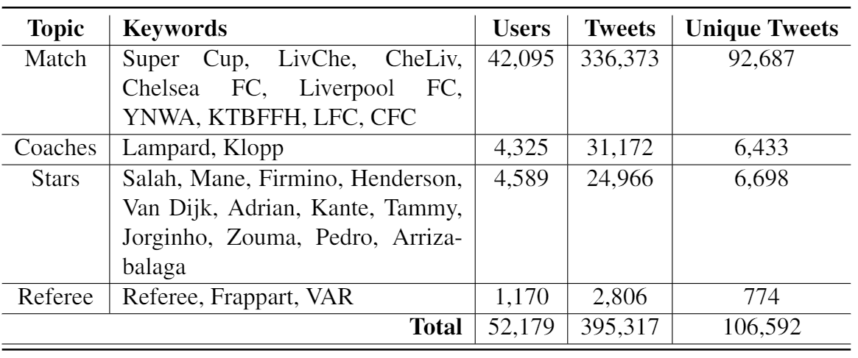
Topics

Slide 49

Can we infer the stance on a topic from a different topic?

Slide 50
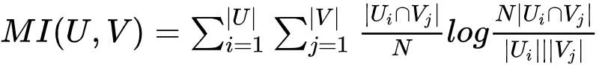
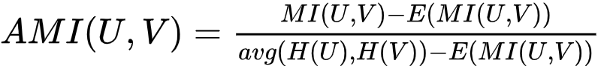
Stance Alignment: Method
Normalized mutual information adjusted for randomness (AMI).
Measures mutual information, or mutual independence, between two clustering solutions.

Slide 51
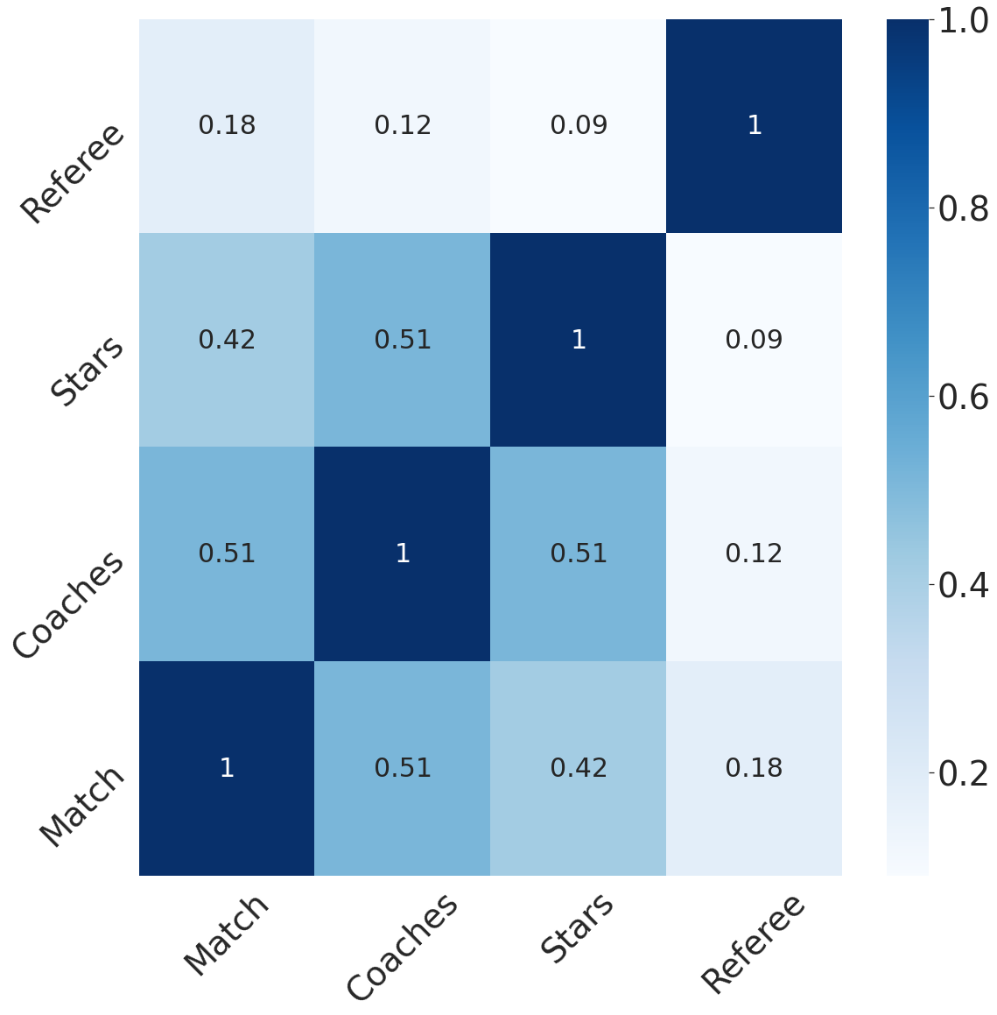
Stance Alignment: Results
Similar:
Match, Coaches, Stars.
Different:
Referee
stances towards clubs are dependent on the stances towards the coaches and the stars, rather than the referee

Slide 52
What does the polarization degree inform us on different topics?

Slide 53
Polarization Quantification: Method
Random Walk Controversy (RWC).
RWC computes the shortest graph traversal from a set of random users to prominent users either with the same or different stances.
prominent nodes are the top n nodes with the most connections in a community.
Where
A and B are different Classes.
P_{XY} is the probability that a random node in X would reach highly connected node in Y.

Slide 54
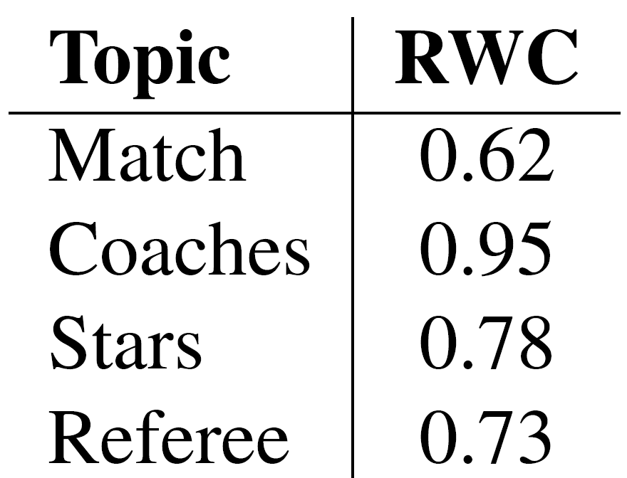
Polarization Quantification: Result
Higher polarization on Coaches
Each cluster is talking mainly about their own coach.
Moderate polarization on Stars
Users from both groups talk about the stars of other teams with a certain level of semantic similarity.
Lower polarization on Referee
Can be attributed to the small size of the dataset

Slide 55
Case Study
Qualitative Analysis

Slide 56
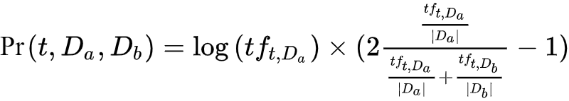
Semantic Difference in Clusters
Valence x log Frequency = Prominence
Prominence of a term t in a set of tweets a, as opposed to the set b
t: term
D_{x}: set of tweets x
tf_{t,Dx}: term frequency of the term t in the set of tweets x
|D_{x}|: sum of the frequencies of all terms in x

Slide 57
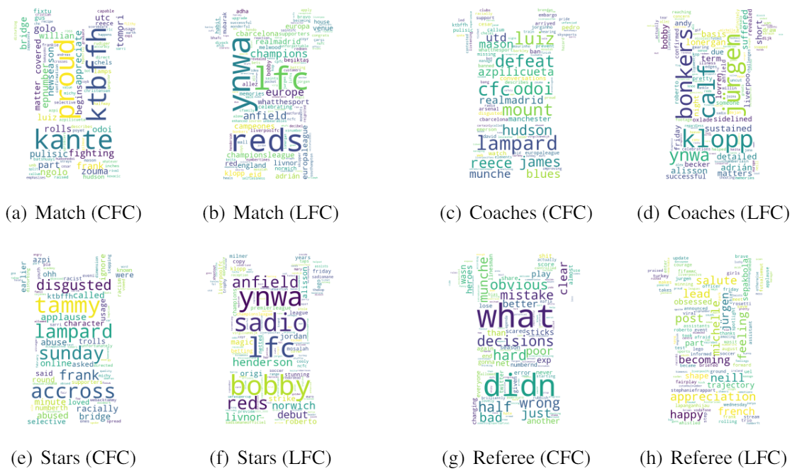
Word Clouds Generated by prominent terms in each cluster for different topics.

Slide 58
Limitation Analysis
Selective retweeting:
RT @LFC: Firmino scores the first penalty of the shootout!
Cross Mentioning:
I respect Liverpool and they had chances in the game but it was clear to me that we were the stronger team
Implicit Criticism:
We won the Super cup with the worst performance since Klopp took over haha #LIVCHE
Post-event Teasing:
@Calabastu VAR knows your penalty wasn't the right call #lfc #cfc
Pre-event Teasing:
#Lampard it’s only #Liverpool on Wednesday #cfc #lfc #ynwa

Slide 59
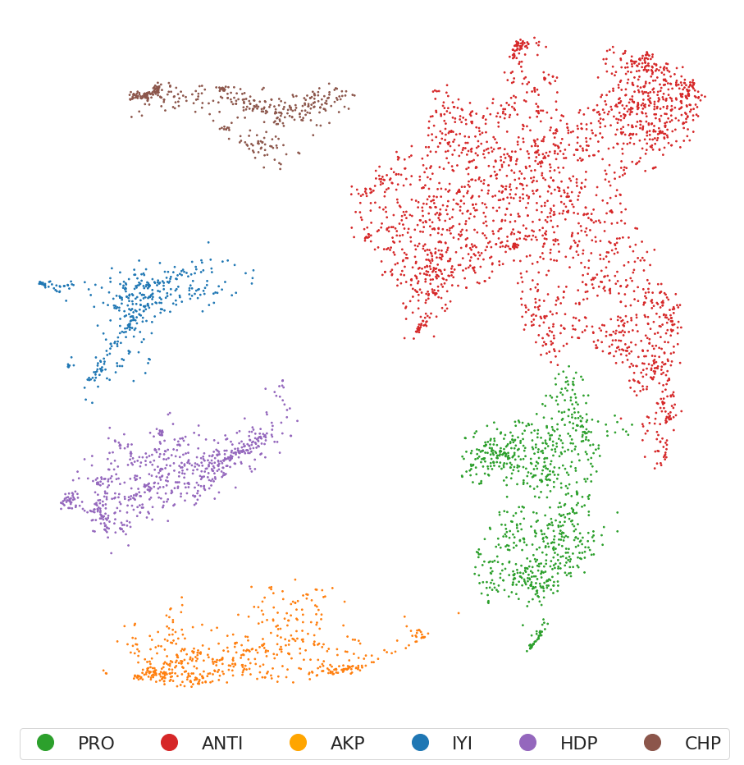
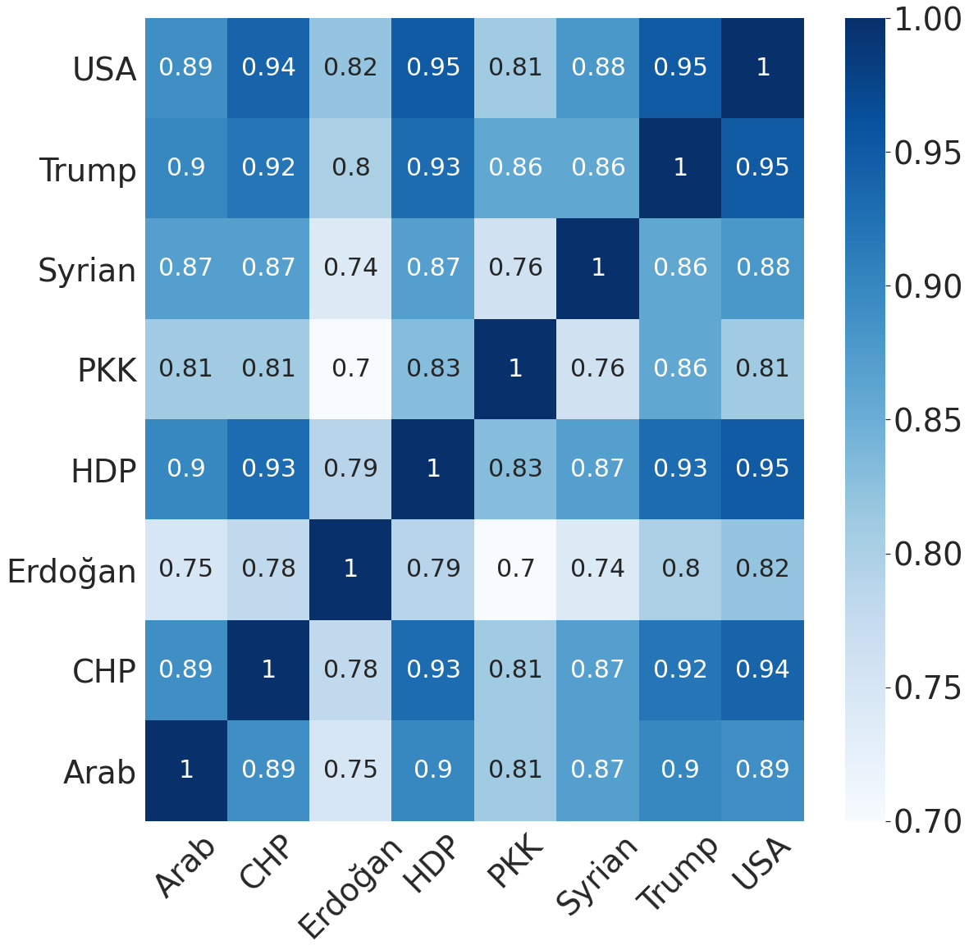
ICWSM: TR elections

Slide 60

Summary
&
Conclusion

Slide 61
Summary
Methodology:
Collect tweets using keywords or usernames.
Encode tweets using a pre-trained sentence encoder, e.g. Universal Sentence Encoder.
Average tweet vectors per user.
Project user vector to a lower dimensional space, e.g. using UMAP.
Cluster projected vectors, e.g. using HDBSCAN.
Analysis:
Stance Alignment with AMI.
Polarization Quantification with RWC.
Semantic Difference using prominence score.

Slide 62
Contributions & Novelty
Performance:
Competitive with supervised approaches.
Outperform previous unsupervised approaches.
Requirements:
No platform-specific features required.
No fine-tuning needed.
Features:
First to use pre-trained sentence embeddings for stance detection.
First to provide hierarchical clustering solution for stances,
Study:
Compiled a dataset of +300k tweets and +12k stance-labeled users.
Provide quantitative and qualitative analysis of polarization in sports.

Slide 63

While at Özyeğin
Full-paper: accepted for ICWSM’21
Embeddings-Based Clustering for Target Specific Stances: The Case of a Polarized Turkey.
Workshop: Ranked 1st in the shared task, LREC | OSACT (May. 2020)
ALT Submission for OSACT Shared Task on Offensive Language Detection.
Poster: Presented at SocInfo (Nov. 2019)
Embedding-based Qualitative Analysis of Polarization in Turkey.
Under review: Submitted at COLING’20
Arabic offensive language on twitter: Analysis and experiments. (already +13 citations)

Slide 64
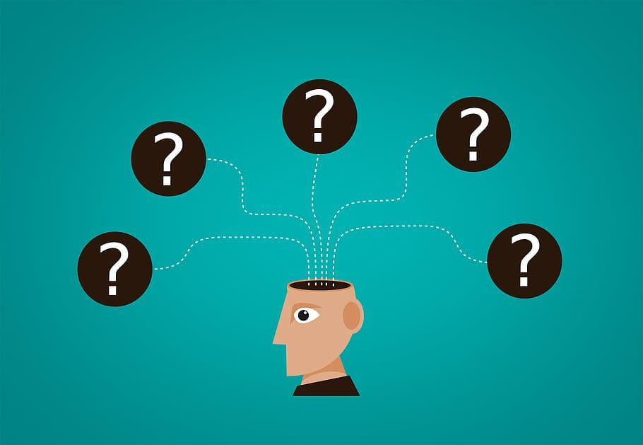
Questions

